Slide 1
Sherbourne House Hotel and Conference Centre
Information Risk Assessment

Slide 2
What have we assessed?
Any and all risks associated with Sherbourne House’s information assets.
This includes guest details, staff credentials and anything else stored in the hotel’s database.
A risk register has been created containing each risk and their relevant details.
The potential threats these risks might lead to.
The treatments used to mitigate the consequences of these risks.
Recovery strategies to clean up any losses incurred.

Slide 3
What are the main risks?
From the risk register, four risks have been selected which are of the greatest concern to Sherbourne House’s information security:
Reference | Brief Description of Risk | Inherent Risk
 |  | Impact | Likelihood | Risk Level
7 | A staff member unintentionally gives away their credentials due to phishing | High | Possible | 18
17 | The same password being used on all E-Mail accounts could lead to a breach. | High | Likely | 20

Slide 4
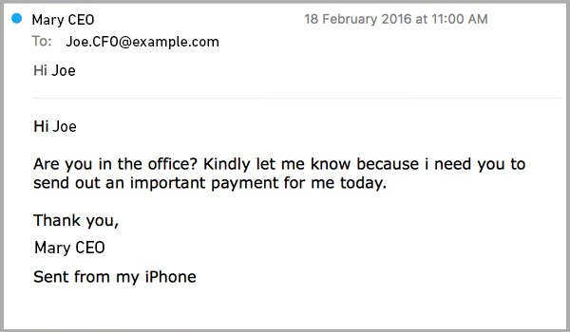
Risk no. 1 - Staff member discloses sensitive information
Risk: A staff member unintentionally gives away their credentials due to phishing.
Staff are expected to receive numerous phishing emails, which intend to deceive the recipient into giving up private information or install malicious software onto their computer.
Some emails might be targeted at Sherbourne House, known as ‘spear-phishing’. These might, for example, trick an employee into giving out login credentials.
Figure 1 – Example of a Spear-Phishing Email (Price, 2016)

Slide 5
Risk no. 1 - treatment
Incorporate spam filters on the mail server that automatically detect phishing scams.
A report button that employees can use to report these emails to the IT Manager.
Include in employee training, how to spot these emails and what to do when one is received.
Perform regular phishing tests to determine if any employees might fall for these emails.
This should also include senior staff members, as their credentials will provide access to more sensitive information.

Slide 6
Risk no. 2 – Poor password management
Risk: As there is no enforced password policy, and staff use their own unique user credentials, the systems are vulnerable to password guessing attacks.
With staff credentials compromised, a threat actor can gain access to potentially sensitive information on the staff and guests of the hotel.
Attackers may also maintain persistence on the network through the use of valid credentials.
This makes it incredibly hard to identify and remove the intrusion.

Slide 7
RISK NO. 2 - TREATMENT
Enforce a password policy with strict enough requirements.
Make sure staff use different unique credentials for each service.
Emphasise and train staff to show the importance of making sure they maintain secure password choices.
Ideally train staff to utilise a password manager
Introduce Multi-Factor Authentication (MFA) to all services where possible, especially crucial services such as the database.

Slide 8
Risk no. 3 – RFID CLONING / UNAUTHORISED ACCESS TO ROOMS
Risks: As every card uses the same technology, a threat actor can 'clone' a card they receive
This would give them unlimited access to any room protected by said key cards
This could enable the most likely threat of theft of guest and staff items
The physical safety of both staff and guests could be jeopardized

Slide 9
RISK NO. 3 - TREATMENT
Deploy encoding software for the access control system
This would allow the credentials for each room to be encrypted to each individual card and room
Cameras should be placed around the hotel to deter and identify potential thieves
Security guards are recommended in order to protect the physical safety of guests and staff, as well as dettering theft.

Slide 10
RISK NO. 4 – Ethernet ports in guest rooms
Risk: Guest users have direct access to any of internal network resources, such as the database, if they connect to the internet via the Ethernet ports in their rooms.
An unauthorised user or threat actor may access internal systems, which contain sensitive personal information such as customer and staff records.
Other threats include the installation of malicious software, and potentially threatening the physical security of staff and guests.

Slide 11
Risk no. 4 Treatment
Implement a Virtual Local Area Network (VLAN) switch on the network.
Essentially segment off the network that the guests use from the staff network.
Alternatively, remove all Ethernet ports from guest rooms
This would force guests to use the guest WiFi
Deploy a firewall, which would allow the IT team to monitor and block/allow specific traffic on the network.

Slide 12
References
Price, R, 2016 BEWARE OF THESE SPEAR PHISHING EMAIL ATTACKS [Online] Available at: https://www.mailguard.com.au/blog/beware-of-these-spear-phishing-email-attacks

